Slide 1
Windows 8/10 Disable Signed Driver Enforcement
Perform this task before coming for IoT Challenge 2018 Event

Slide 2
Follow below Steps
Click the Start menu and select Settings.
Click Update and Security.
Click on Recovery.
Click Restart now under Advanced Startup.
Click Troubleshoot.
Click Advanced options.
Click Startup Settings.
Click on Restart.
On the Startup Settings screen press 7 or F7 to disable driver signature enforcement.

Slide 3
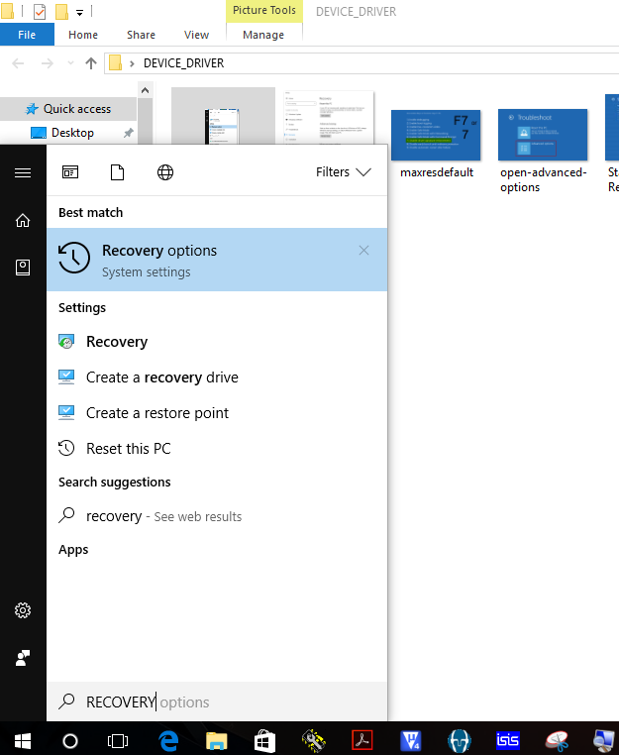
DISABLE DRIVER SIGNATURE ENFORCEMENT

Slide 4
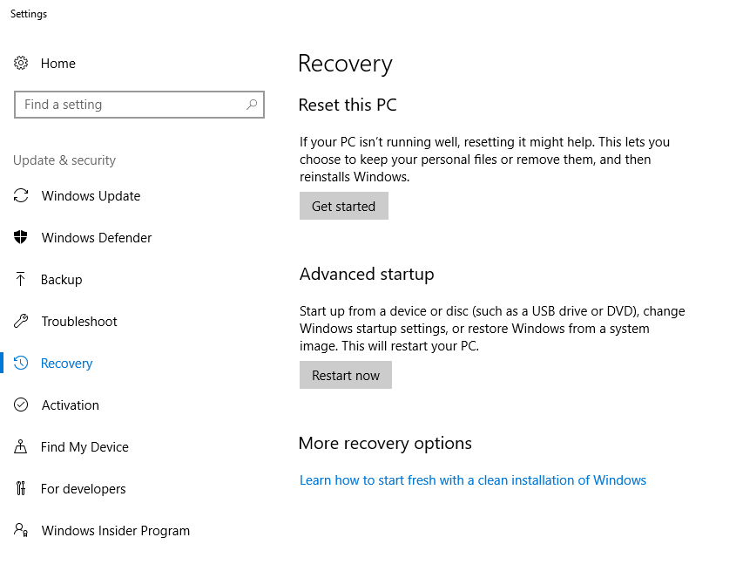
DISABLE DRIVER SIGNATURE ENFORCEMENT

Slide 5
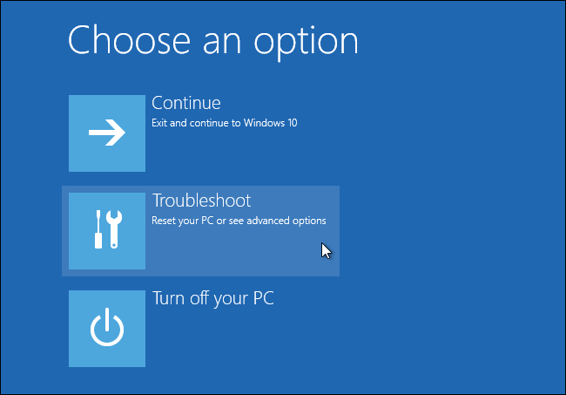
DISABLE DRIVER SIGNATURE ENFORCEMENT

Slide 6
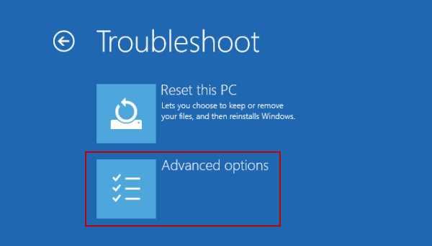
DISABLE DRIVER SIGNATURE ENFORCEMENT

Slide 7
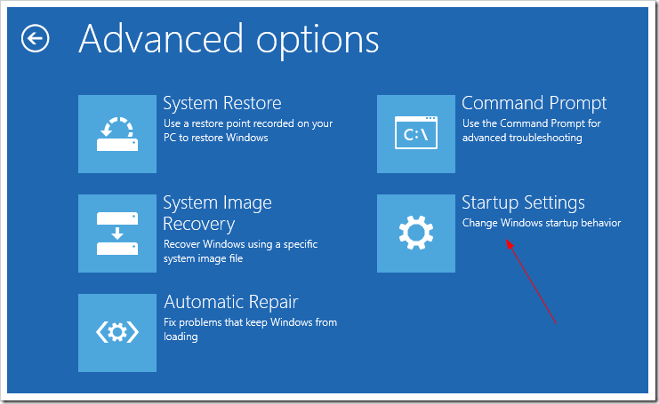
DISABLE DRIVER SIGNATURE ENFORCEMENT

Slide 8
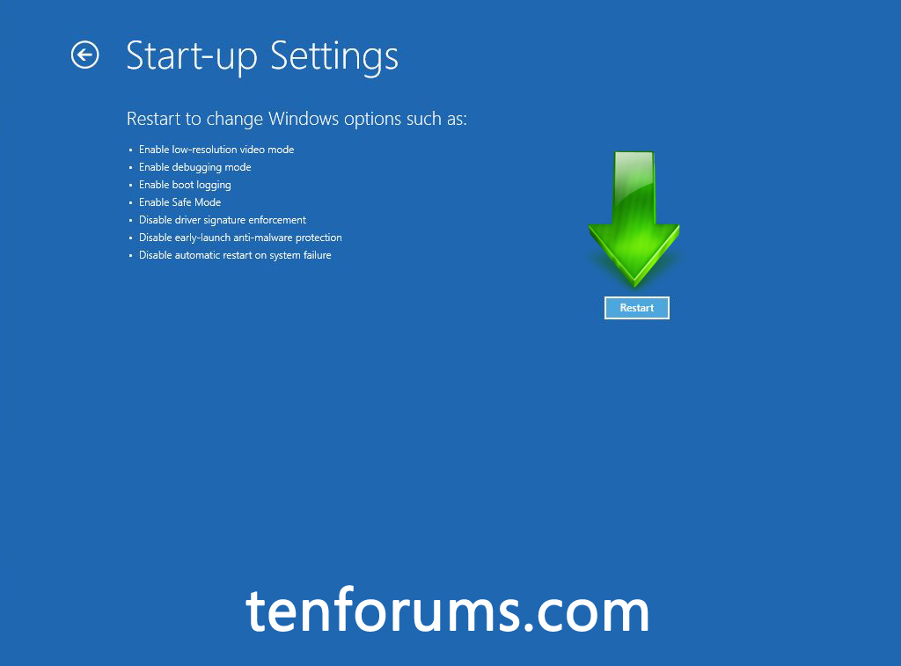
DISABLE DRIVER SIGNATURE ENFORCEMENT

Slide 9
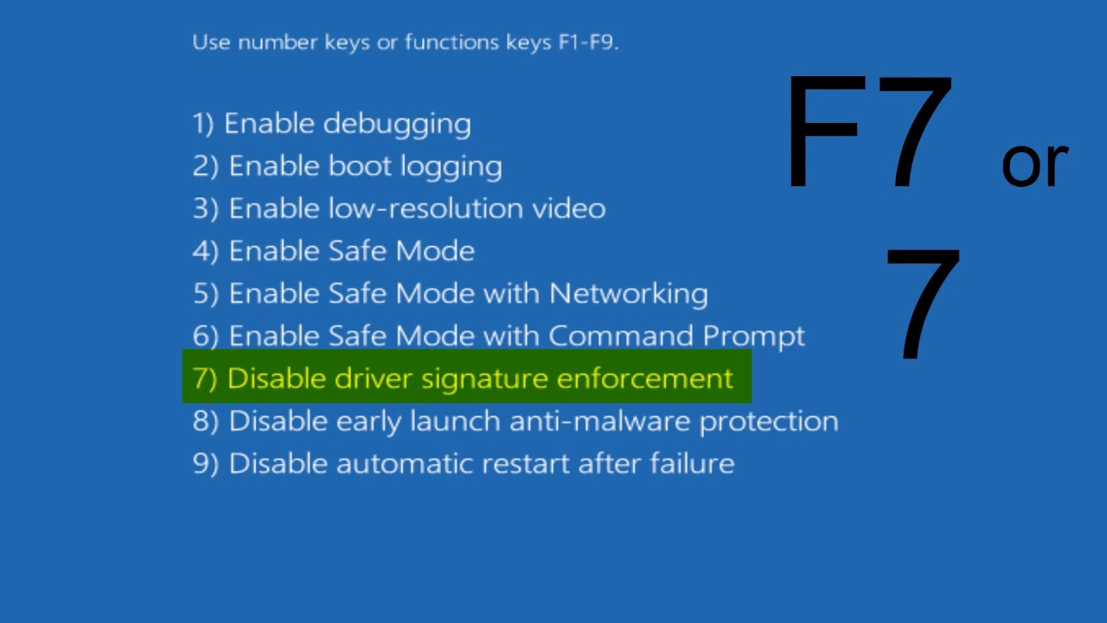
DISABLE DRIVER SIGNATURE ENFORCEMENT

